Slide 1
LinkedIn Webinar – Rutgers University
October 2019
Stan Robinson, Jr
www.linkedin.com/in/stanrobinson

Slide 2
Today We’ll Cover
Why LinkedIn is an important element of your professional reputation
Best practices for crafting an effective LinkedIn profile
Using LinkedIn as part of your professional networking strategy
Demonstrating your academic expertise and thought leadership on LinkedIn
LinkedIn for Career Advancement
Questions

Slide 3
Why Use LinkedIn?
Manage your professional reputation
Build your professional network
Find valuable resources
Communicate with the professional community
Notes:
Think about your LinkedIn strategy and develop a routine of regular activities for best results.

Slide 4

LinkedIn Profile – Tip of the Iceberg

Slide 5
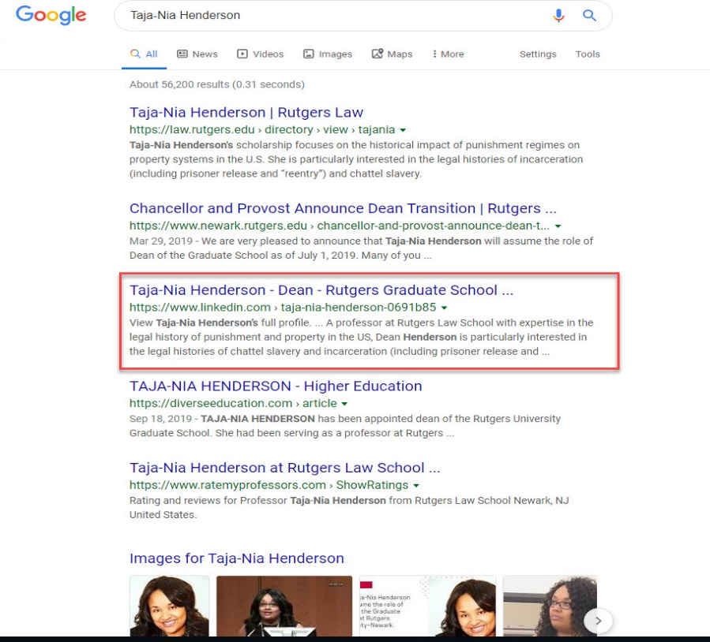
Google Search

Slide 6
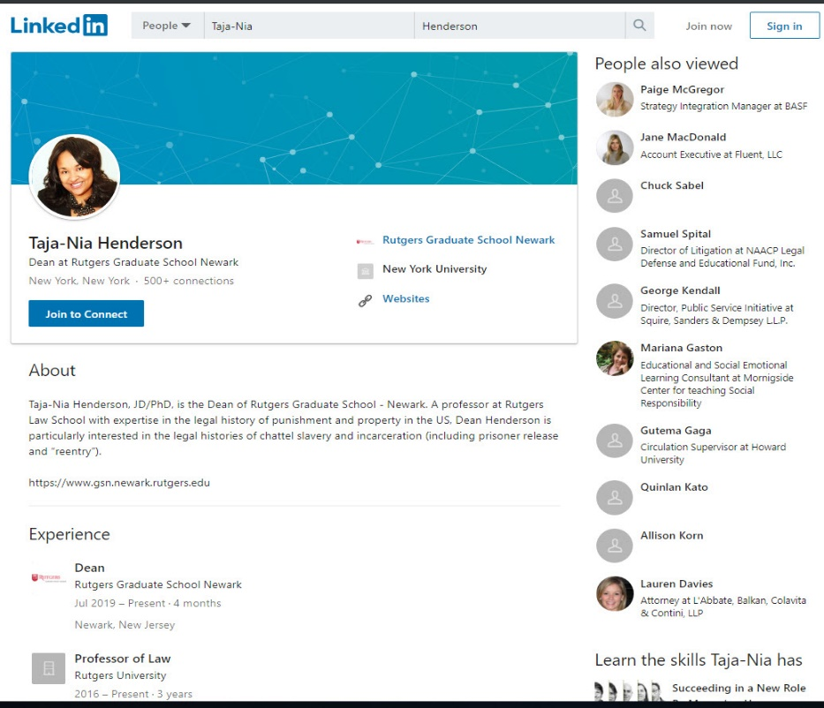
Google Search

Slide 7
3 Mistakes to Avoid
Photo
Professional Headline
About/Summary section
Notes:
Do this first. Everything begins with your profile.
LinkedIn’s criteria for a complete profile are not enough to get the most from it.
Use keywords and industry terms.
You control how you appear in Google search results. (show)

Slide 8
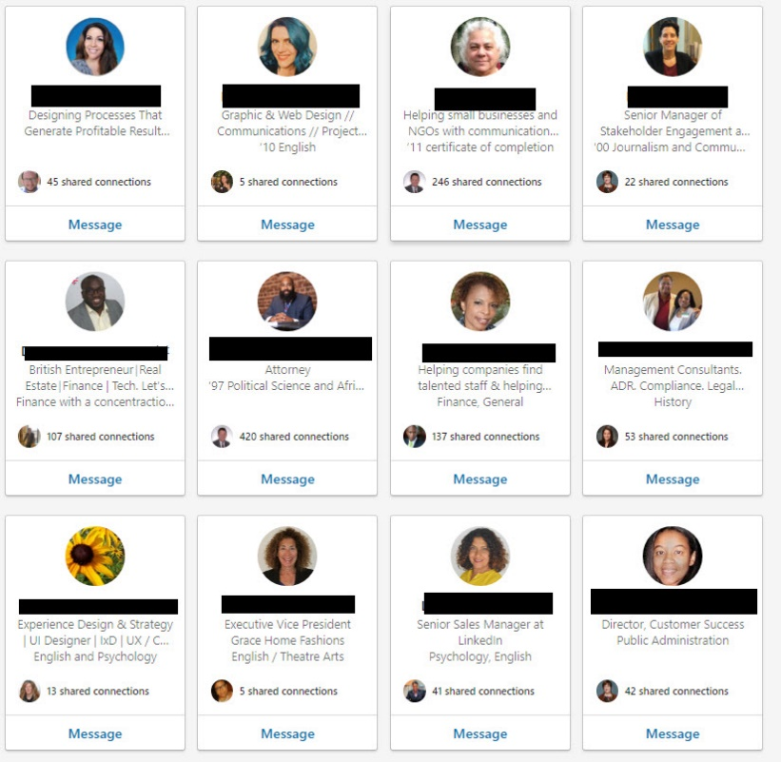
LinkedIn Profile - Photo

Slide 9
LinkedIn Profile - Headline
Urban Economic Developer | Professor | Entrepreneur | Deal Maker | Investor
Univ. of Toronto graduate with MSc in biochemistry | 7 years of writing experience seeking a science journalism position
Criminology Major with 3.9 GPA | Special Interest in Lowering Recidivism | Seeking Internship
Notes:
Header
Edit contact info
Public profile

Slide 10
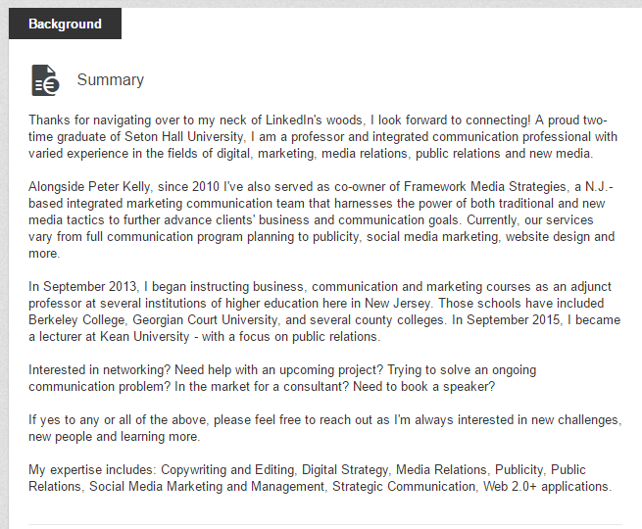
LinkedIn About/Summary

Slide 11
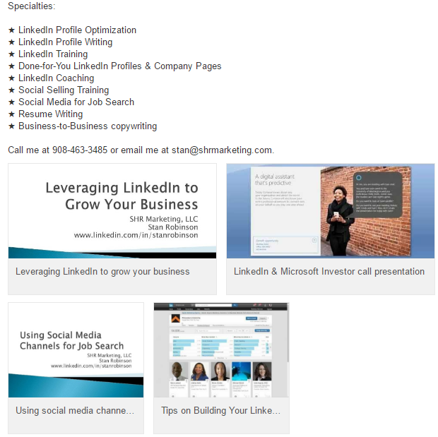
Use Multimedia

Slide 12
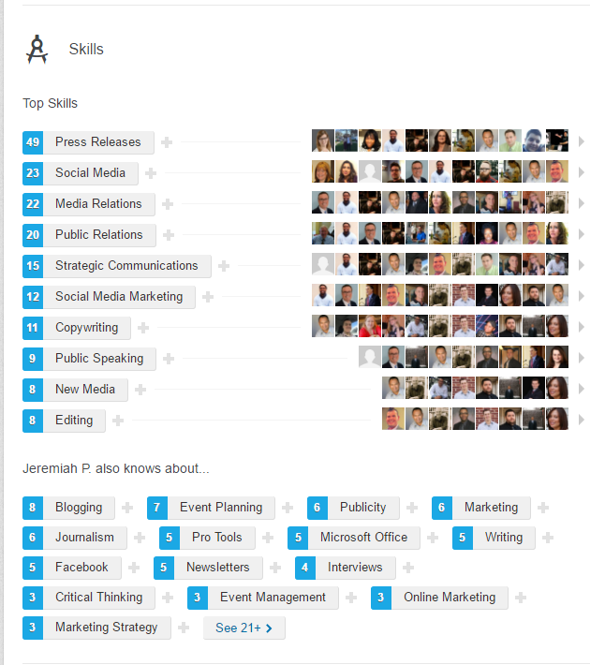
Skills

Slide 13
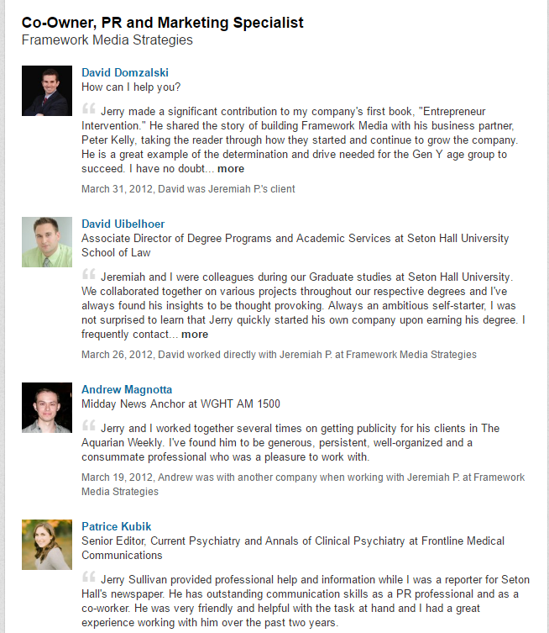
Recommendations

Slide 14
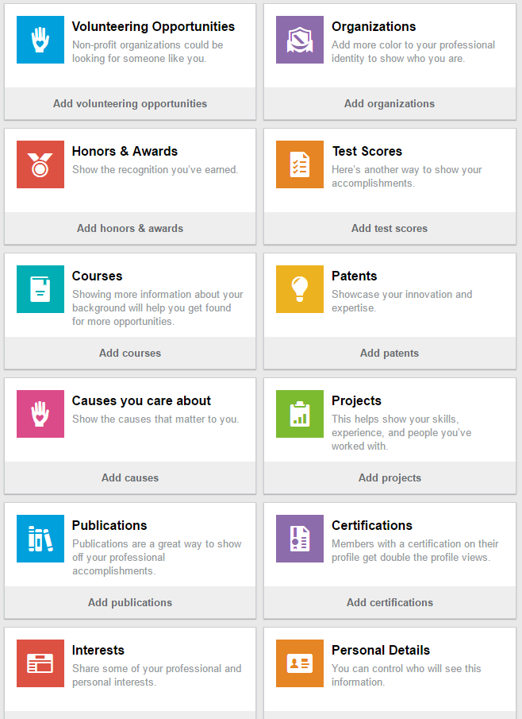
Other Sections

Slide 15
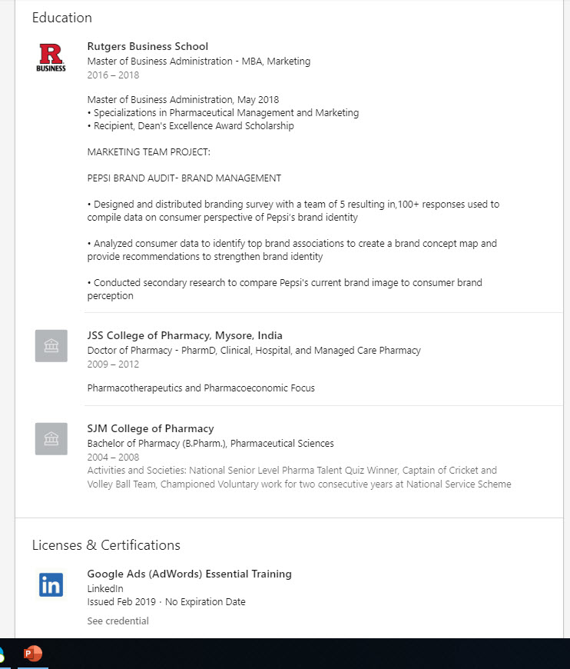
Education

Slide 16
Build Your Connections
Power of your network
Bring your offline network online
Determine connection criteria
Notes:
Connect with people who know you - colleagues, classmates, friends, family, people you do business with, fellow organization members, etc.
Power in asking your sphere of influence for introductions to those you want to meet.

Slide 17
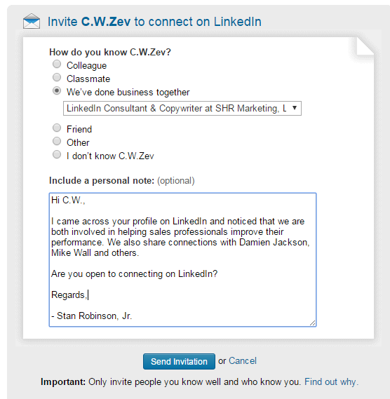
Personalize Invitations

Slide 18
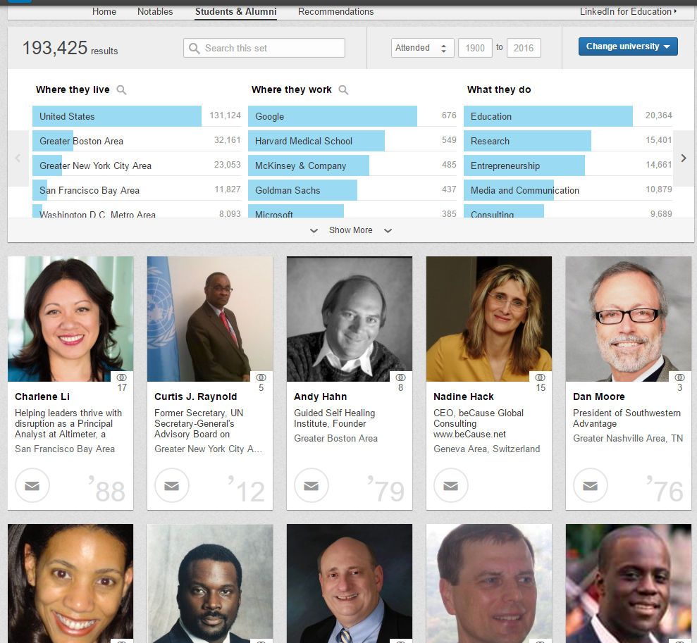
Find Alumni

Slide 19
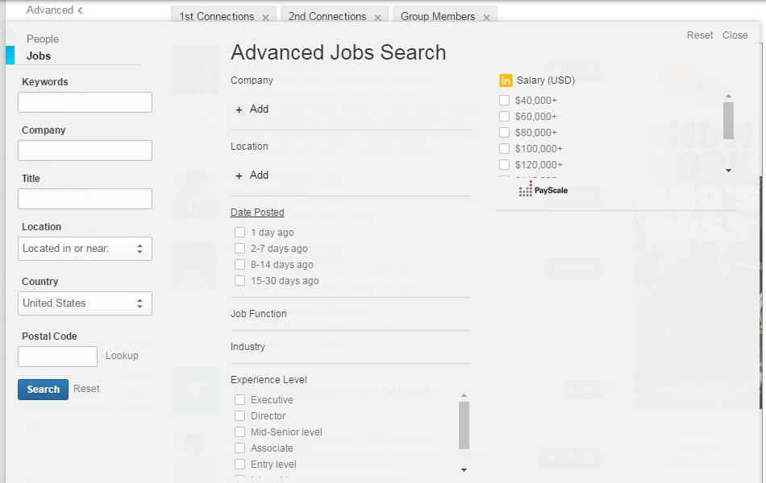
Advanced Jobs Search

Slide 20
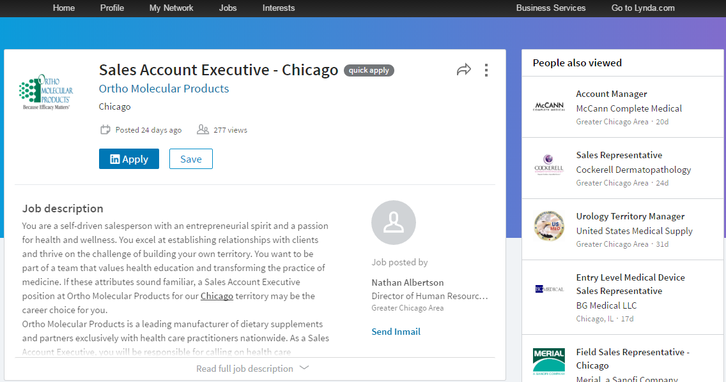
Job – Apply Through LinkedIn

Slide 21
For Students Getting Info Interviews
Sample message to your target person:
Dear Mr. Picone, I am an MBA student at XXX University, interested in entering the XXX industry when I graduate in the Spring of 20xx. Looking over your current and past positions within the XXX industry, I thought you would be an excellent person to ask questions about (Your target company) and the industry in general. Having worked at XXX as a research technician for X years, I am now looking to advance my career in a different direction, and work on the business end within the pharmaceutical industry. I would very much like to set up a time to speak with you, either over the phone or in person. Please let me know if this is possible. I can be reached at GK@rutgers.edu and 888.555.1212. Thank you for your time, Mary Sample

Slide 22
For Professionals Getting Info Interviews
Sample message to your target person:
Dear Mr. Picone, I obtained your name through the (name the common LinkedIn group or network) on LinkedIn. I have been working at (name last position) and I am in the process of making a career transition. It would be helpful for me to ask you questions about your experiences as an (name role) for (target company). I promise not to take more than 15 minutes of your time. I am not expecting to discuss a particular employment position but I would appreciate being able to talk with you on an informational basis. What is the best way to reach you this week? I have Thursday at 9 and Friday at 2pm available. I thank you in advance. Regards, Gitta Kwainted

Slide 23
Additional Resources
LinkedIn for Graduate Students: https://www.utm.utoronto.ca/careers/sites/files/careers/public/shared/images/linkedin/LinkedIn%20for%20Graduate%20Students%20Handout%20package.pdf
Post on how academics can use LinkedIn:
https://www.linkedin.com/pulse/how-do-academics-use-linkedin-isabeau-iqbal/
Videos with LinkedIn tips: https://www.youtube.com/Vengreso

Slide 24
Contact Information
Stan Robinson, Jr.
Phone: 908-463-3485
Email: stan@vengreso.com
LinkedIn: www.linkedin.com/in/stanrobinson
Twitter: @stanrobinson
Website: www.vengreso.com

